Slide 1

Reading JavaScript objects
From JS to JSON to JSONP

Slide 2
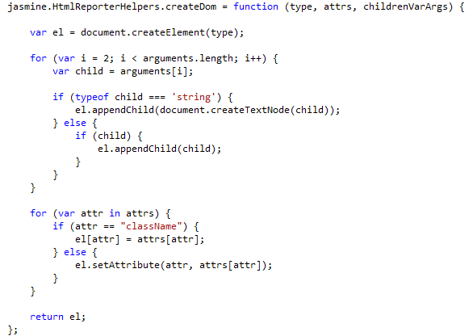

Being able to read JS
Could you create a checkbox that uses the “test” class?
Create a Div with hello world and a checkbox?
Wrong answer goes boom

Slide 3

What I find confusing
Why does JavaScript sometimes die when something doesn’t happen and sometimes it just keeps going?
Why are there parameters inside of functions without any parameters on the parent function?
How do I know what to pass?
How come you can pass extra parameters without a problem?
What values am I allowed to see in the object?

Slide 4

Why????
Multidevice ===HTML (5)
JavaScript is engine of HTML
HTML app is most portable
More js libraries appear everyday which we can steal to do our work
You will read more JavaScript every few months
Need to understand objects and scope or you will misunderstand what you are reading
Every VS version includes more JavaScript libraries

Slide 5

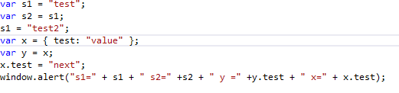
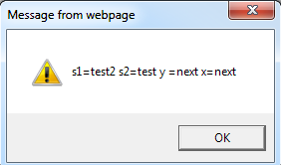
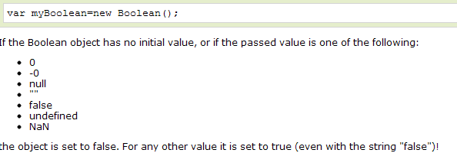
JavaScript Types
String
Non-mutable
Number
Boolean
Falses are defined
Object
All are references
Var x= y;
Y=10→x=10
Date
Really an object

Slide 6
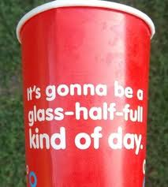
Everything is an object-kinda
Prototypical Inheritance
Anything in the prototype goes to next object
No classes
Prototype.js is a way to get JavaScript to have pseudo classes (Ruby style)
Functions have weird object rules
Can return a function or value
Can’t always go functionname.variable
Let’s learn objects first before we do functions as objects

Slide 7
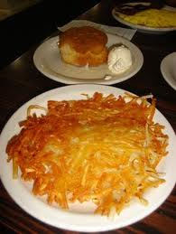
Object is a hash
Named pairs
Value can be:
String
Number
Bool
Object
Function
Date

Slide 8
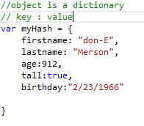
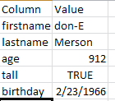
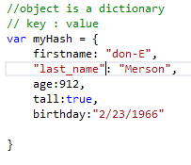
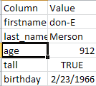
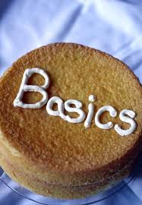

Basic Object Notation
{}= Object
{
Name: ”value”
}

Slide 9

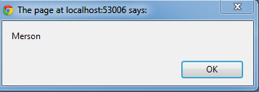
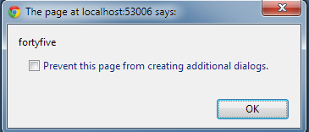


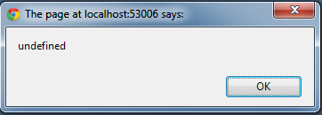

Now we can refer to the object
This is your basic null scenario.
Does not break app.
Information is correct

Slide 10
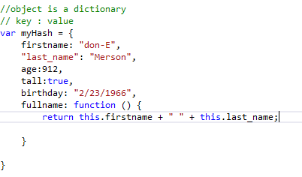

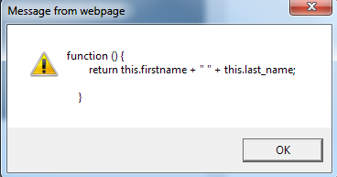

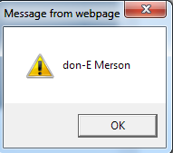
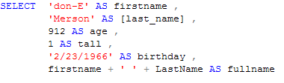
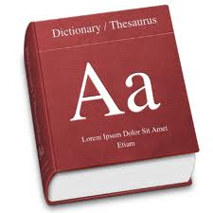
A JavaScript object can have an function as a value!
Function calls without the () will return definition
No way to visualize in excel

Slide 11
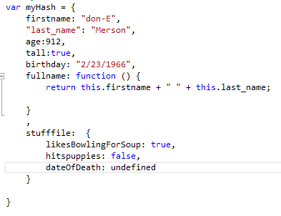
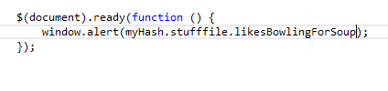
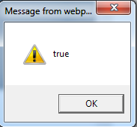
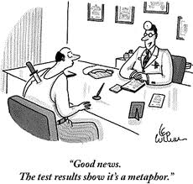
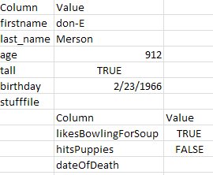
JavaScript can have an object as a value!

Slide 12
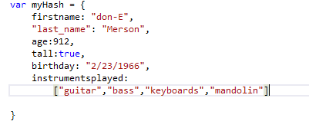

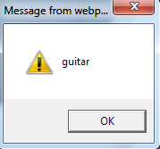
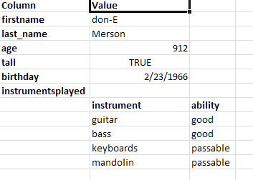
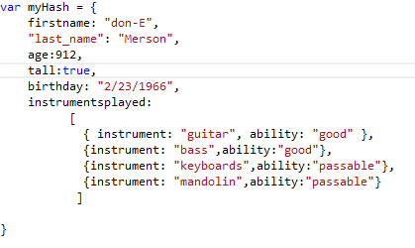
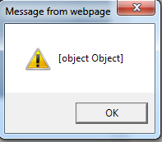
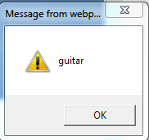


A JSO can have an array as an object value
JSO can have arrays of objects

Slide 13

don-E’s syntax tips
JavaScript objects are not square
Can be very nested
Don’t try to remember your place as you go along
Draw array first if item is array []
Draw one object at a time {}
Draw item.function({}); first if applicable
Draw key values with blank or {} first
Fill in values after you have wrapper correct

Slide 14
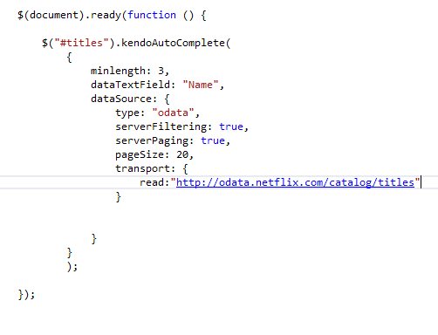
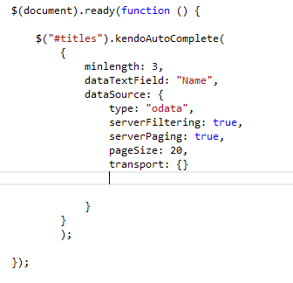
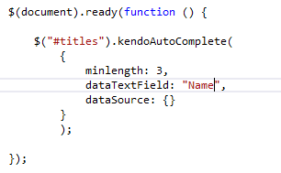
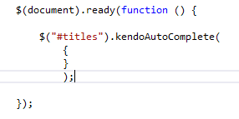

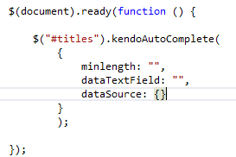
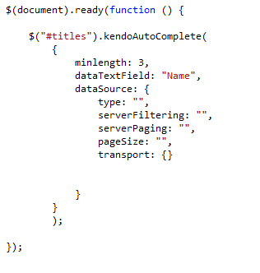
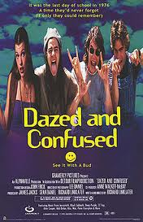
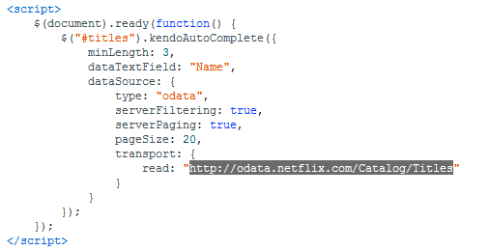
That bottom part is confusing if you try to write it all out

Slide 15
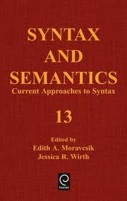
Syntax Review
Statements
End with ;
Sometimes optional
function(){};
Items inside are statements → end with ;
Return is a statement
Return can be object →return {};
Object {}
Items inside objects are separated with ,
Property:value
Value can be object, function, value or array
Arrays []
[ myValues ]
Separate objects by ,
Array of objects possible [{},{}]
Array of objects and values too [“one”,{two:2},”three”]
Call functions with ()
Assignment x=y;

Slide 16


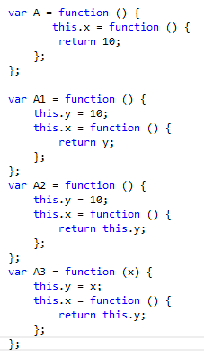




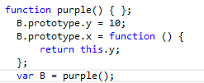
Examples first
Note anonymous
This is global

Slide 17

What to learn from this
New creates a new scope
No “new” means this is global object
No “this.” means global object
Call properties with ()
Call methods with () or get definition
Prototypes are weird

Slide 18

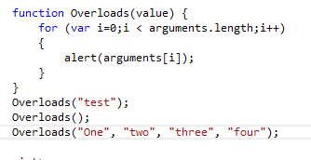
Other Weird JSO items
All functions have an arguments psuedo array
Can’t pop or push list
Can iterate it
Allows for really weird overloads

Slide 19
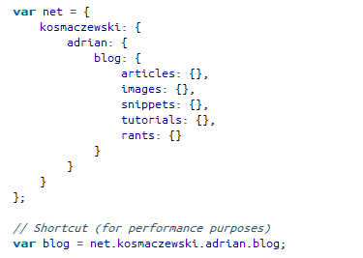

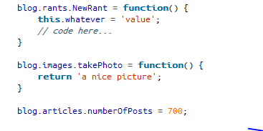
Namespaces
Helps remove JavaScript variable collisions

Slide 20
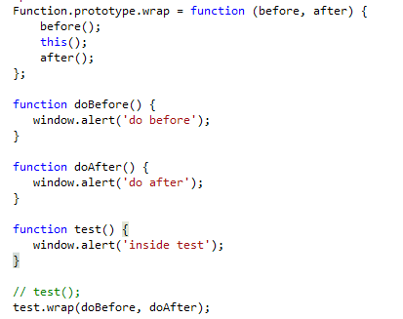

Can do pre and post object stuff

Slide 21

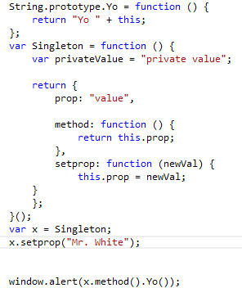
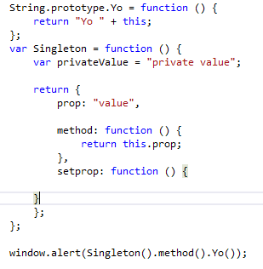
Yo lambda
JavaScript-lambda like LINQ
Override prototype to add lambda expression
“Yo value”

Slide 22
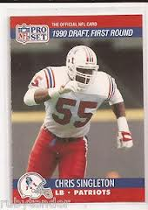
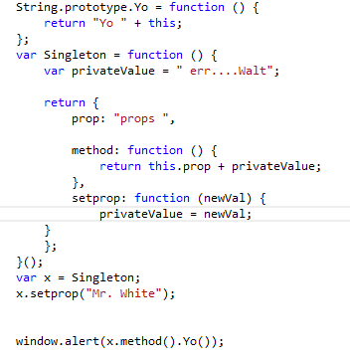
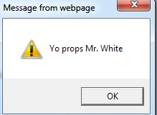
Singleton
Note: returns object
Note: () at end
If not there need Singleton() first
Return object has 3 items
Prop
Public variable
Method
Function
Setprop
Changes value
Import tip-return{}; is one statement
If you miss ; →object will break

Slide 23

Rules for understanding
Any variable inside of a function labeled var is private to function
Any variable inside of a function labeled without var is private to function
Any variable inside of a function labeled this is public to global (window)
Scope for function
Inside of return –public
Outside of return with this-global
Otherwise-private

Slide 24


What can you see?
privatevalue
Nope
gMoney
window.gMoney
Noise
S.noise
S.shoot();
What is x.noise?
“Clang”
What is s.noise?
“Clang”

Slide 25


Selfish variables
Note: var self =this;
Allows you to get level above in private method

Slide 26


toString()

Slide 27



Exceptional objects
Calling object.value with no object causes exception

Slide 28

Prototypes in Javascript
Prototypes allow you to add properties or methods to a function/object
Overriding prototypes adds functionality
This pattern is used in popular libraries
jQuery
prototype

Slide 29



jQuery Extend is prototype

Slide 30


jQuery validate addmethod

Slide 31

Challenge
First need to create lower objects
And there are a couple of different ways

Slide 32


Fake objects

Slide 33


Object structure
Note-empty object in 2nd parameter
String, array –make exception

Slide 34

Important syntax to understand
el[attrs]=attrs[attr]
el and attrs are objects
attrs is a property of El
attrs is an object
attr is a property of attrs
el[attrs] =set object
attrs[attr]=set value
el.setAttribute
attr,
attrs[attr]

Slide 35


Answer
Go to know some JavaScript
Overloads
Need to recognize object

Slide 36

JSON vs. JSONP
When you get data from another domain
Need JSONP
Just wraps the object in a function
Prevents script injection
Remember a value of an object can be a function
Call function after getting data

Slide 37


JSONP vs. JSON
Call results array

Slide 38
Many ways to bind client side
Kendo
Telerik
Knockout.js
MVVM
Model View ViewModel
Bind to objects for arrays
Bind to properties for element (singular)

Slide 39
Knockout basics
Include knockout.js
Create a view model
Bind the view model
Observable makes dynamic
Invoked with ()
Add data-bind attribute
binding:[ value || object || function]
value:’hello’
text:’mytext’
click: function(){};

Slide 40




Observe

Slide 41



View Model-Kendo
Dropdown

Slide 42






Kendo Binding Step by Step
Includes the files are make a Kendo project
Start with basics
Add view model
Seed Model
Bind Model to Form
Bind form elements to key

Slide 43



Kendo action

Slide 44

Templates Guidelines

Slide 45


Kendo Templates
Defined the template
Var template=kendo.template(“my #=girlname#”);
Define the data (if necessary)
Var data={“girlname:’Sharona’”}
Append the template to a HTML element
$(“myDiv”).append(template(data));

Slide 46



Remember it is JavaScript
This works-→
This doesn’t→
This either→

Slide 47


For array need a template
Template is script with special type
Append to element with data in same way

Slide 48
Other Weird JSO items
All functions have an arguments psuedo array
Can’t pop or push list
Can iterate it
Allows for really weird overloads

Slide 49
Closure basic definition
An inner function always has access to the vars and parameters of its outer function, even after the outer function has returned
Whenever you use function inside another function, a closure is used.
A closure in JavaScript is like keeping a copy of the all the local variables, just as they were when a function exited.
Two functions might look like they have the same source text, but have completely different behaviour because of their 'hidden' closure. I don't think JavaScript code can actually find out if a function reference has a closure or not.

Slide 50

Closures-Pre Concepts
Function
; between statements
Pass a value
Returns value
Return a function
Note
sayHello(“Bob”) returns definition
sayHello(“Bob”)() returns “Hello Bob”
Can’t get text value i.e.-not an object exactly

Slide 51

Closure example
a closure is the local variables for a function - kept alive after the function has returned
In JavaScript, if you declare a function within another function, then the local variables can remain accessible after returning from the function you called.

Slide 52


Closure scope

Slide 53



More closure scope

Slide 54



The ultimate in crazy

Slide 55


Runtime objects
Important
someref is an object
someVar is an property of object defined at runtime

Slide 56
Ugh…
So we learned about JavaScript objects
What they are (sometimes)
What the function and prototype words change
Finding where “this” is
Binding
JSON
JSONP
Closures

